Slide 1

CSC- 362 Computer Networks Week:15 Lecture:19 - 20
Prepared by:
Mr. Attique Ur Rehman

Slide 2
Application Layer

Slide 3
The Big Picture
Final exam is here
You are almost here

Slide 4
Application Layer
Outline
Application Layer Protocols

Slide 5
Where we are now …
Understand how to
Build a network on one physical medium
Connect networks together (with switches)
Implement a reliable byte stream on Internet
Implement a UDP/TCP connection/channel
Address network heterogeneity
Address global scale
End-to-end issues and common protocols
Congestion control and resource allocation
Today’s topic
Applications, with focus on their protocols

Slide 6
Application Layer Protocol
Networking support:
Domain Name System (DNS)
File transfer:
File Transfer Protocol (FTP)
Trivial File Transfer Protocol (TFTP)
Remote login to hosts:
Telnet
Electronic mail transport:
Simple Mail Transfer Protocol (SMTP)
Multipurpose Internet Mail Extensions (MIME)

Slide 7
Application Layer Protocol
Host initialization:
BOOTP
Remote host management:
Simple Network Management Protocol (SNMP)
Common Management Information Protocol over TCP (CMOT)

Slide 8
Domain Name Service (DNS)
Translates Internet domain names into IP addresses
Example of a distributed application
Defined in RFC’s 1034 and 1035
DNS Outline
Comparison of domain names and addresses
Domain name hierarchy
Implementation of hierarchy
Name resolution (name to address translation)

Slide 9
Domain Names and Addresses
Internet domain names: human readable
Mnemonic of variable length
e.g., donald2.inria.fr
IP addresses: easily handled by routers/computers
Fixed length string tied (loosely) to geography
e.g., 131.126.143.82
Levels of hierarchy
Each capable of arbitrary number
AS implements beyond two levels

Slide 10
Domain Name Hierarchy
Structure: period-separated identifiers
Host name first
Each subsequent component is larger group
Little-endian ?
org
net
com
mil
edu
gov
pk
fr
mit
edu
ietf
ibm
inria
yahoo
uiuc
www
cupidon
research
ee
cs
case

Slide 11
Domain Name Hierarchy
Each identifier (after host name) denotes a zone
Translation for each zone supported by 2+ name servers
org
net
com
mil
edu
gov
pk
fr
mit
edu
ietf
ibm
inria
yahoo
uiuc
www
cupidon
research
ee
cs
case
Example zones

Slide 12
Domain Name Service
Name servers maintain
Collection of resource records (5-tuples: name, value, type, class, TTL)
Each record is a translation based on type
Type=A: name=full domain name, value=IP addr.
Type=NS: name=subzone name, value=subzone name server’s full domain name
Type=CNAME: name=domain name alias, value=canonical domain name for host
Type=MX: name=zone name, value=maildrop host’s full domain name

Slide 13
Domain Name Service
Resource record tuple format: (name, value, type, class, TTL)
Class
Generally set to IN (Internet)
Allows use of DNS for other purposes
Not often used, however
TTL (time to live)
Guarantee on translation validity
Used for caching; discard copy on timeout

Slide 14
Examples of Resource Records
Root name server: (<name, value, type, class>)
<arizona.edu, telcom.arizona.edu, NS, IN >
<telcom.arizona.edu, 128.196.128.233, A, IN >
< bellcore.com, thumper.bellcore.com, NS, IN >
< thumper.bellcore.com, 128.96.32.20, A, IN >

Slide 15
Examples of Resource Records
Arizona’s name server: (<name, value, type, class>)
<cs.arizona.edu, optima.cs.arizona.edu, NS, IN>
<optima.cs.arizona.edu, 192.12.69.5, A, IN>
<ece.arizona.edu, helios.ece.arizona.edu, NS, IN>
<helios.ece.arizona.edu, 128.196.28.166, A, IN>
<jupiter.physics.arizona.edu, 128.196.4.1, A, IN>
<saturn.physics.arizona.edu, 128.196.4.2, A, IN>

Slide 16
Examples of Resource Records
Arizona’s CS name server: (< name, value, type, class>)
<cs.arizona.edu, optima.cs.arizona.edu, MX, IN>
<optima.cs.arizona.edu, 192.12.69.5, A, IN >
<opt.cs.arizona.edu, optima.cs.arizona.edu, CNAME, IN >

Slide 17
Name Resolution Example
www.ece.uiuc.edu
.edu root name server
uiuc.edu; 131.126.10.23
www.ece.uiuc.edu
local name server
www.ece.uiuc.edu
UIUC name server
client
131.126.150.25
ece.uiuc.edu; 131.126.150.1
www.ece.uiuc.edu
ECE name server
www.ece.uiuc.edu; 131.126.150.25

Slide 18
Traditional Applications
Directly invoked by users
Employ the request/reply paradigm
Own RPC-like mechanism on top of TCP/UDP
Distinction between application programs and application protocols
E.g. web browser and HTTP
Companion protocols specifying data format
E.g. MIME with SMTP, HTML with HTTP, etc.

Slide 19
Electronic Mail
One of the most successful application of the Internet
Understanding how email works requires to distinguish
The user interface from underlying message transfer protocol, i.e. mail reader from SMTP
The transfer protocol and a companion protocol that defines format of messages being exchanged, i.e. SMTP from RFC 822 + MIME

Slide 20
RFC 822 Message Format
Message have two parts: header and body
Both parts are represented in ASCII text
Header is separated from the message body by a blank line
Message header is a series of lines containing type and value separated by a colon
Some fields are filled by user (e.g. To: ), other are filled by the mail delivery system (e.g. Date: )
RFC 822 explains all header fields …

Slide 21
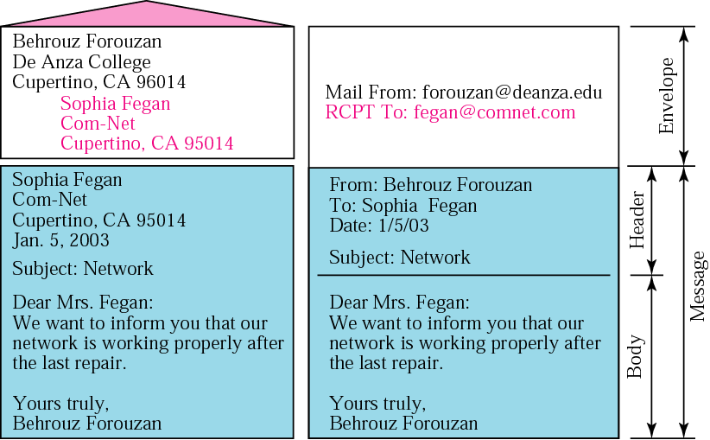
Format of an Email

Slide 22
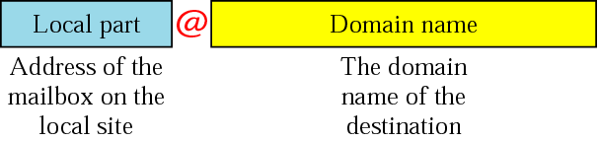
Email Address

Slide 23
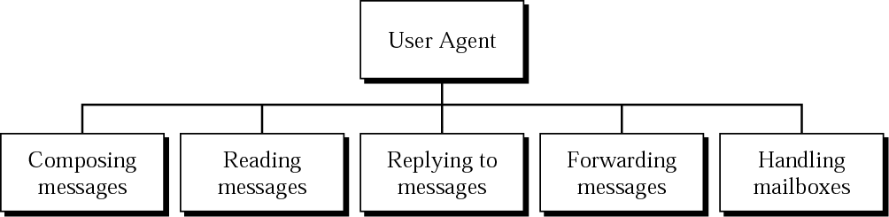
User Agent
Some examples of command-driven user agents are mail, pine, and elm
Some examples of GUI-based user agents are Eudora, Outlook, and Netscape

Slide 24
Multipurpose Internet Mail Extensions (MIME)
RFC 822 was extended to allow email messages to carry many different types of data: audio, images, documents, …
Mime consists of three basic pieces
The first piece is a collection of header lines that augment the original set defined by RFC 822
Describe the data being carried in the message body
E.g. content-type, content-transfer-encoding, etc.

Slide 25
MIME
Second piece is definitions for a set of content types and sub-types
image/gif, image/jpeg
text/plain, text/richtext (marked up text with fonts, etc.)
application/postscript, application/msword
“Multipart” type defines how message carrying different data types is structured
Each piece has its own header line describing the type

Slide 26
MIME
Third piece is a way to encode various data types
After encoding, whole message is an ASCII text
Message passes through a number of gateways that assume all email is ASCII
MIME uses base64 encoding of binary data into the ASCII character set
Map every three bytes of original binary data into four ASCII characters
Grouping data into 24-bit pieces, then to four 6-bit pieces which maps to one of 64 valid ASCII characters

Slide 27
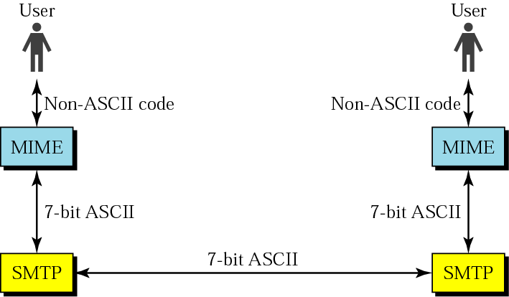
MIME

Slide 28
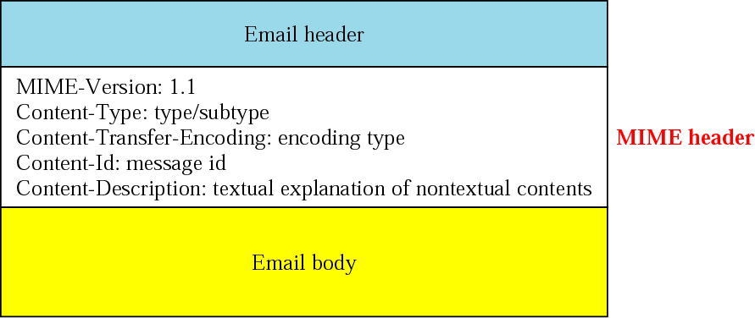
MIME Header

Slide 29
Data Types and Sub-types in MIME
Type | Subtype | Description
Text | Plain | Unformatted text
Multipart | Mixed | Body contains ordered parts of different data types
 | Parallel | Same as above, but no order
 | Digest | Similar to mixed, but the default is message/RFC822
 | Alternative | Parts are different versions of the same message
Message | RFC822 | Body is an encapsulated message
 | Partial | Body is a fragment of a bigger message
 | Ext. Body | Body is a reference to another message
Image | JPEG | Image is in JPEG
 | GIF | Video is in GIF format
Video | MPEG | Video is in MPEG format
Audio | Basic | Single-channel encoding of voice at 8 KHz
Application | PostScript | Adobe PostScript
 | Octet-Stream | General binary data (8-bit bytes)

Slide 30
Content-transfer Encoding
Category | Description
Type | ASCII characters and short lines
7bit | Non-ASCII characters and short lines
8bit | Non-ASCII characters with unlimited-length lines
Binary | 6-bit blocks of data are encoded into 8-bit ASCII characters
Base64 | Non-ASCII characters are encoded as an equal sign followed by an ASCII code

Slide 31
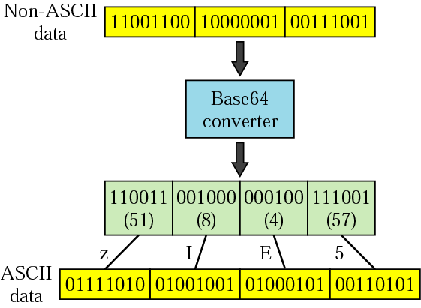
Base 64

Slide 32
Base 64 Encoding Table
Value | Code | Value | Code | Value | Code | Value | Code | Value | Code | Value | Code
0 | A | 11 | L | 22 | W | 33 | h | 44 | s | 55 | 3
1 | B | 12 | M | 23 | X | 34 | i | 45 | t | 56 | 4
2 | C | 13 | N | 24 | Y | 35 | j | 46 | u | 57 | 5
3 | D | 14 | O | 25 | Z | 36 | k | 47 | v | 58 | 6
4 | E | 15 | P | 26 | a | 37 | l | 48 | w | 59 | 7
5 | F | 16 | Q | 27 | b | 38 | m | 49 | x | 60 | 8
6 | G | 17 | R | 28 | c | 39 | n | 50 | y | 61 | 9
7 | H | 18 | S | 29 | d | 40 | o | 51 | z | 62 | +
8 | I | 19 | T | 30 | e | 41 | p | 52 | 0 | 63 | /
9 | J | 20 | U | 31 | f | 42 | q | 53 | 1
10 | K | 21 | V | 32 | g | 43 | r | 54 | 2

Slide 33
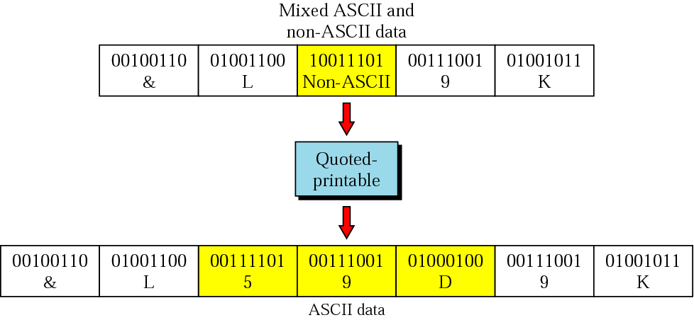
Quoted-printable

Slide 34
Message Transfer – SMTP
Users interact with a mail reader
Mail daemon (or process) running on each host playing the role of a post office
Mail reader gives message to mail daemon
Mail daemon used SMTP (running on TCP) to transmit message to a daemon on another machine
Daemon puts incoming message into user mailbox
Mail reader can read the message later

Slide 35
Mail Transfer – SMTP
SMTP implementations are derived from sendmail
Often the mail traverses one or more mail gateways on its route from sender to receiver
Mail gateways also run a sendmail process and store and forward email messages
Mail gateways buffers messages on disk and try retransmitting them to the next machine for several days

Slide 36
Mail Gateways
Why are mail gateways necessary?
Recipient does not want to include his host’s name in his email address
Recipient’s machine may not always be up
Independent SMTP connection between mail gateways (and hosts)
Multiple messages may be transferred in single session
SMTP client posts a command and the server responds with a code

Slide 37
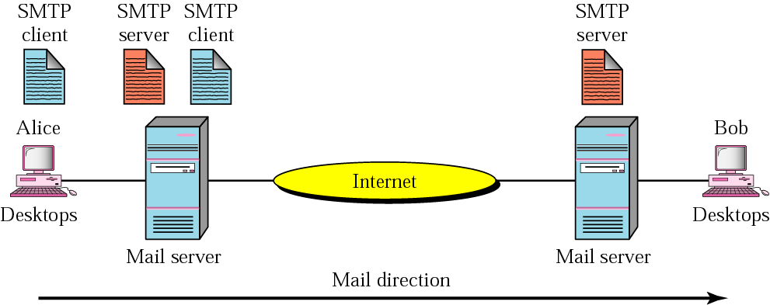
MTA Client and Server

Slide 38
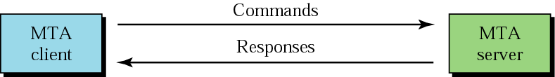
MTA – Commands and Responses

Slide 39
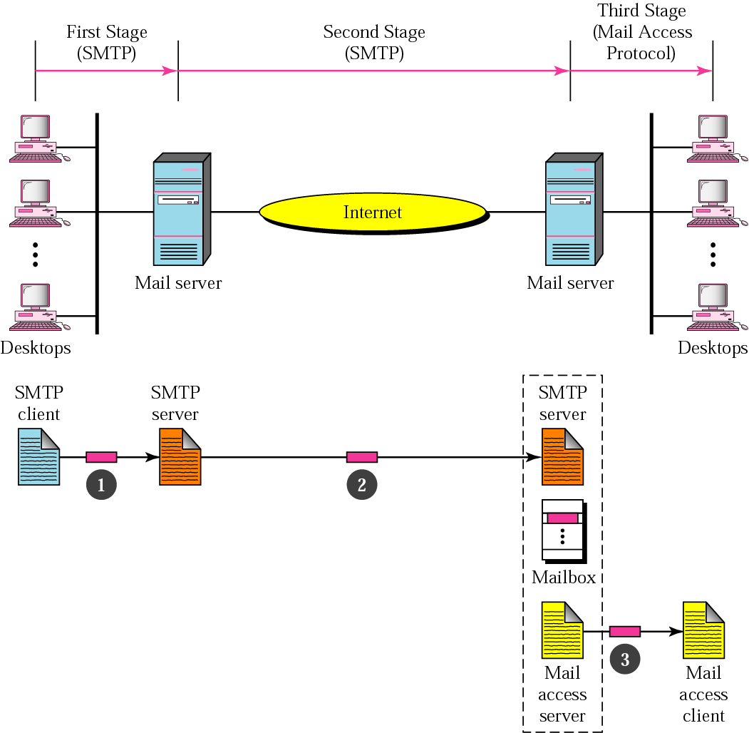
Email Delivery

Slide 40
Mail Reader and Mail Access Protocol
User performs all actions by interacting with the mail reader
E.g. retrieves its mail from the mailbox at the server
Mail reader uses mail access protocol to retrieve messages from the server
Internet Message Access Protocol (IMAP)
Post Office Protocol (POP)

Slide 41
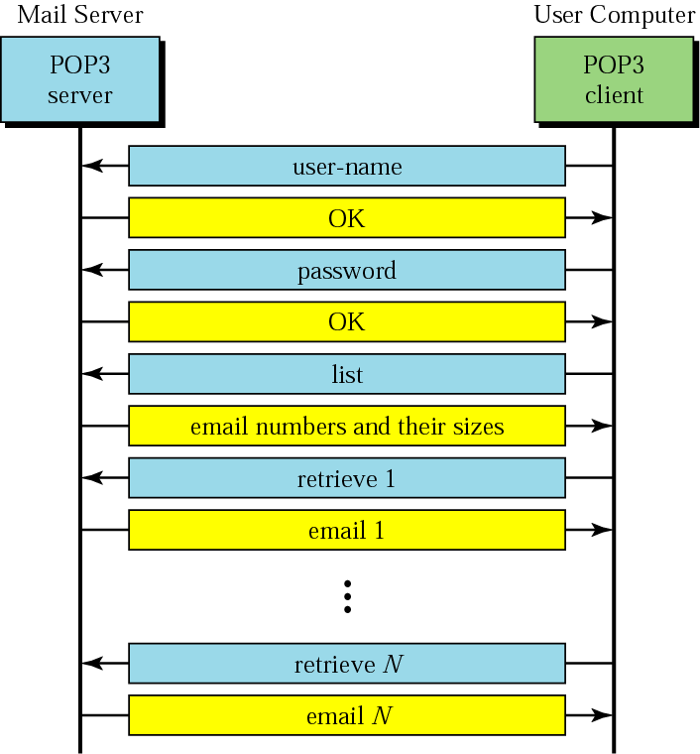
POP3

Slide 42
World Wide Web (HTTP)
Very successful application of the Internet
Set of cooperating clients and servers, speaking the same language: HTTP
Graphical client program (web browser) displays a page of information
Browser allows the user to open a URL (Uniform Resource Locator): location of object on the web
Browser opens a TCP connection (on the well-known port 80) to web servers

Slide 43
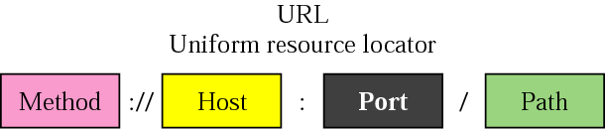
World Wide Web (HTTP)
Files on the web contain text, images, …
Also include URLs that point to other files
Embedded URLs are called hypertext links
Embedded URLs may be followed by opening a new connection to retrieve and display the object
Object fetched using text-oriented protocol HTTP
Request/response messages with options and parameters

Slide 44
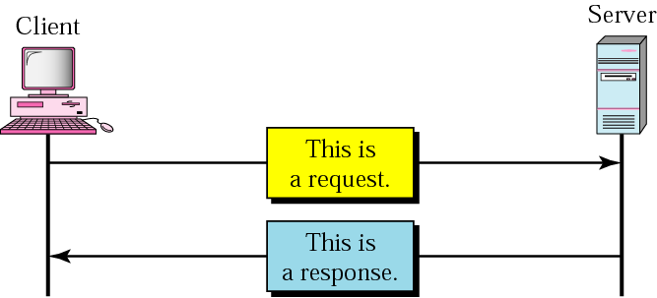
HTTP Transaction

Slide 45
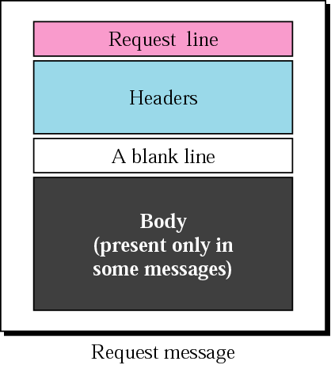
Request Message

Slide 46
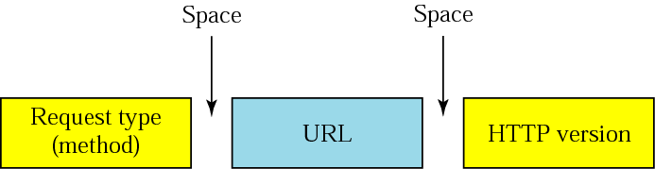
Request Line
HTTP request message specifies operation to be performed, web page the operation should be performed on, and the HTTP version
E.g. GET http://www.case.edu.pk HTTP/1.1

Slide 47
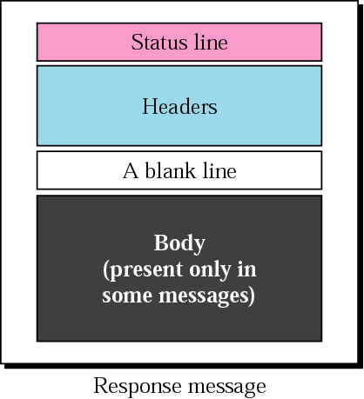
Response Message

Slide 48
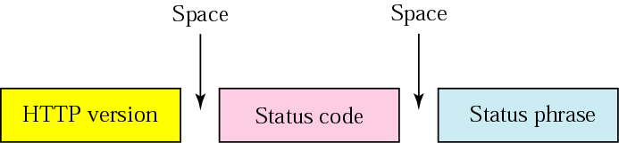
Status Line
Response message begins with the status line specifying the version of HTTP, 3-digit code indicating success or not, and the text string giving the reason
E.g. HTTP/1.1 202 Accepted

Slide 49
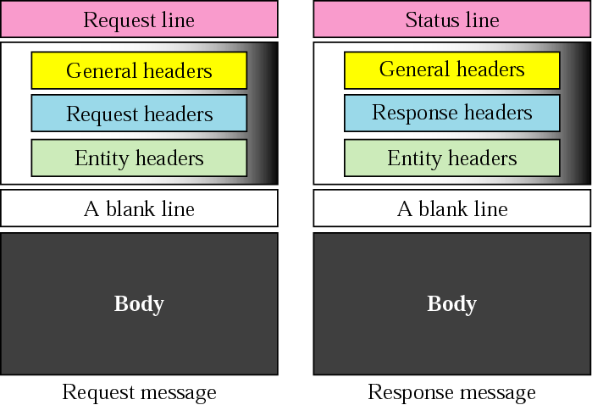
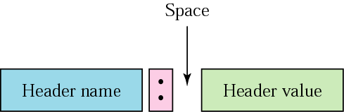
Headers and Header Format

Slide 50
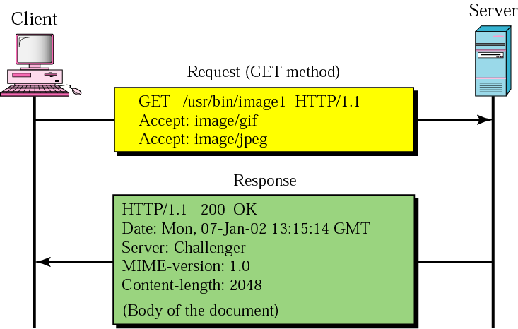
HTTP Example 1

Slide 51
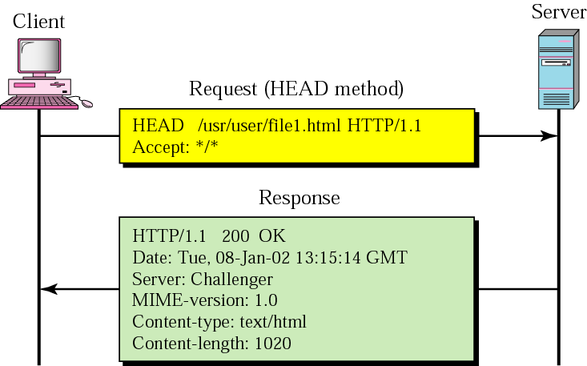
HTTP Example 2

Slide 52
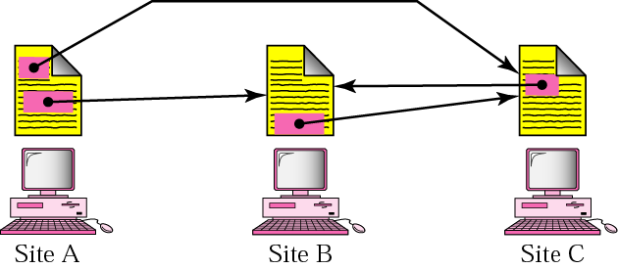
Distributed Services

Slide 53
HTTP and TCP Connections
HTTP 1.0 establishes a separate TCP connection for each data item retrieved
Inefficient mechanism with connection setup/teardown
HTTP 1.1 allows persistent connections
Client and server exchange multiple request/response messages over the same TCP connection
Reduced load on server, lesser delay, etc.
With persistent connections, neither the client nor the server knows how long to keep the connection open

Slide 54
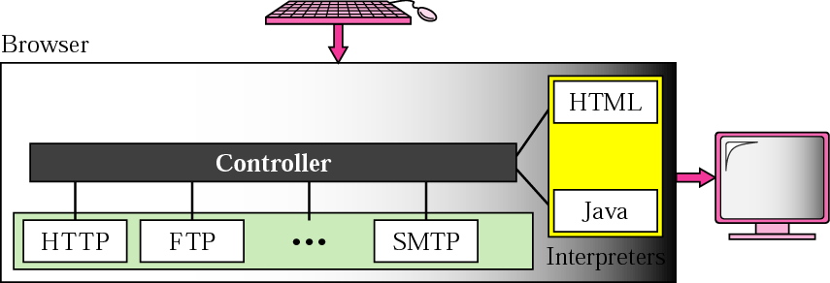
Browser Architecture

Slide 55
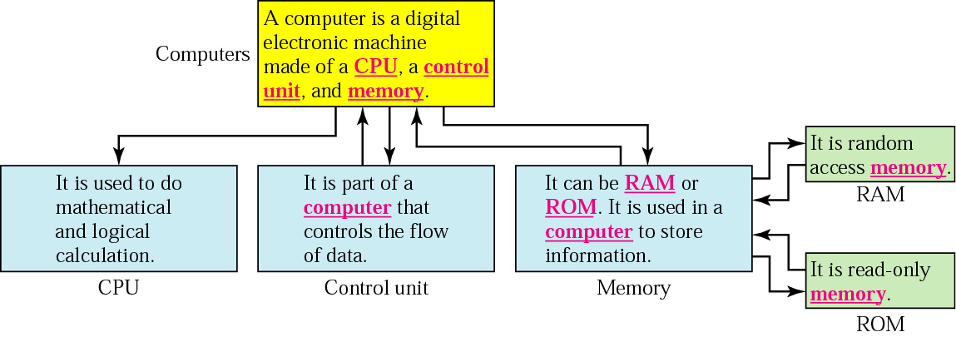
Hypertext

Slide 56
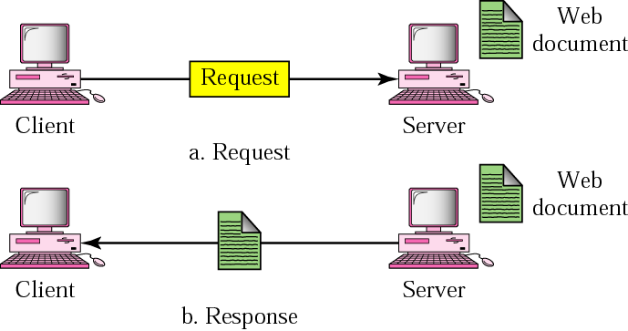
Static Document

Slide 57
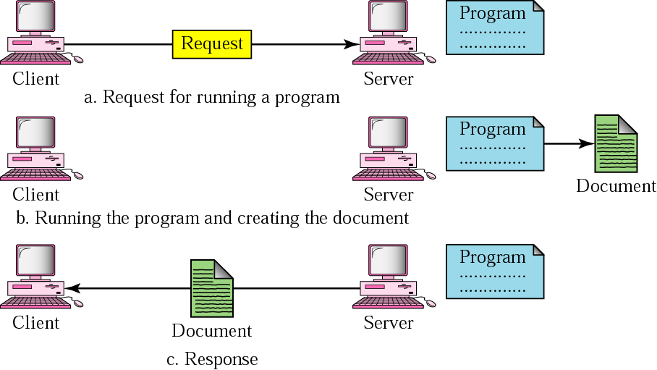
Dynamic Document

Slide 58
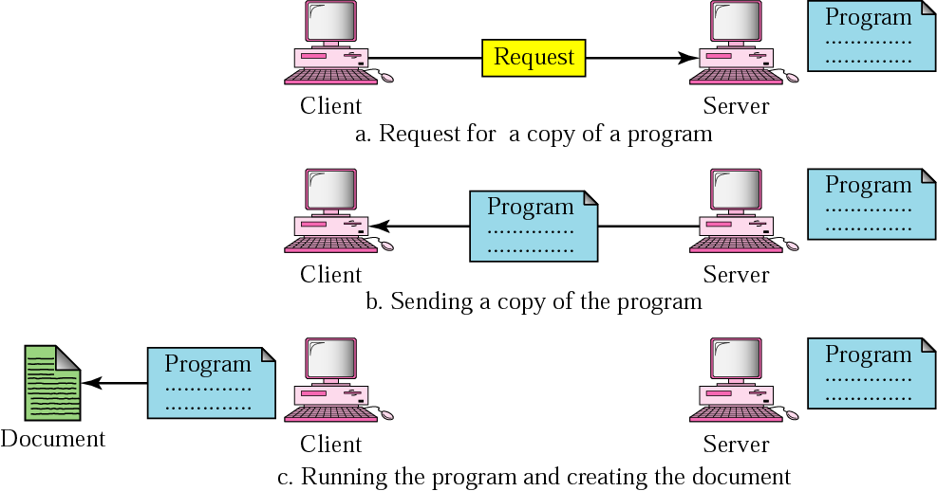
Active Document

Slide 59
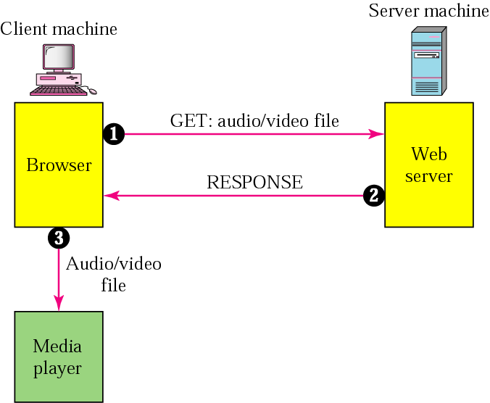
Streaming Stored Audio/Video: Using a Web Server

Slide 60
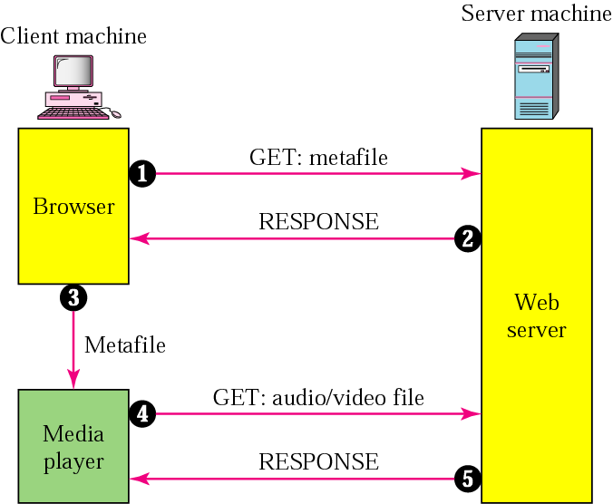
Streaming Stored Audio/Video: Using a Web Server with a Metafile

Slide 61
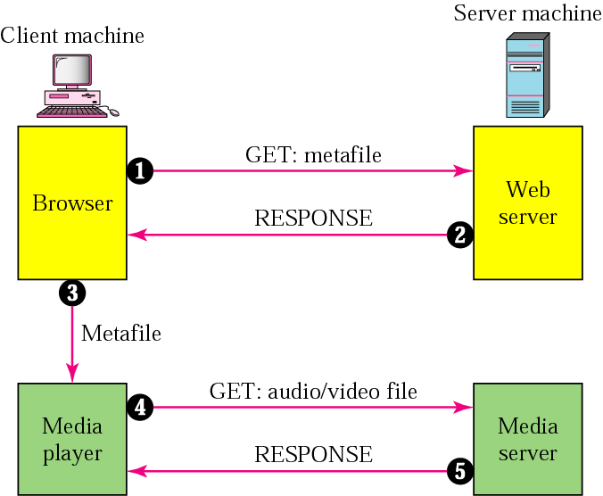
Streaming Stored Audio/Video: Using a Media Server

Slide 62
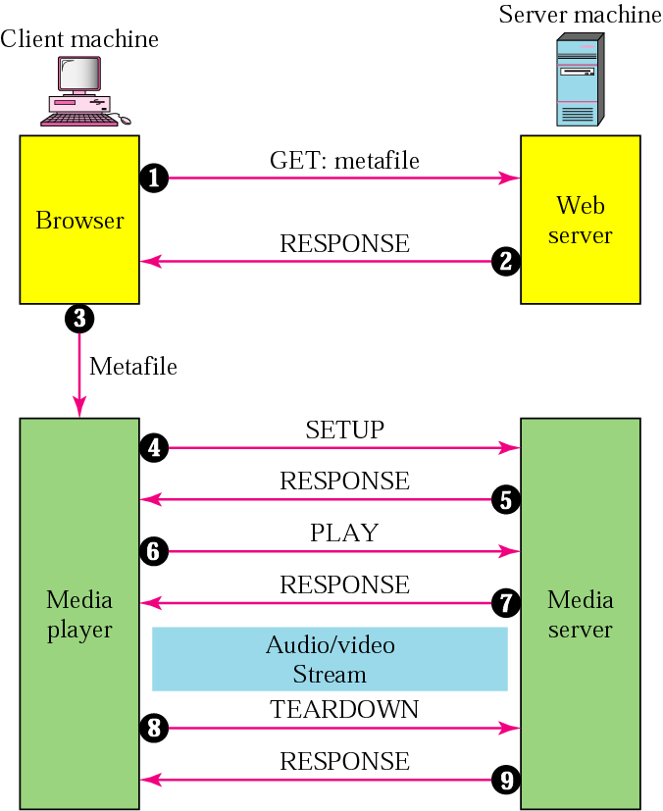
Streaming Stored Audio/Video: Using a Media Server and RTSP

Slide 63
Real-time Transport Protocol (RTP)
Application-Level Framing
Data Packets
sequence number
timestamp (app defines “tick”)
Control Packets (send periodically)
loss rate (fraction of packets received since last report)
measured jitter

Slide 64
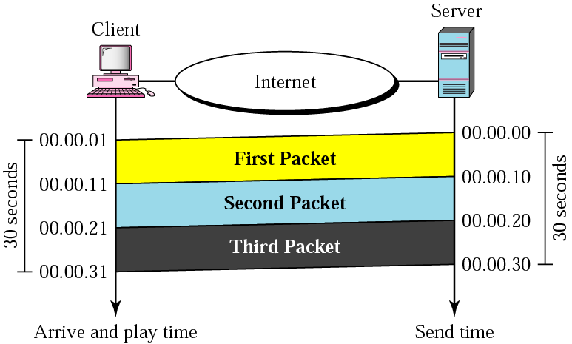
Time Relationship

Slide 65
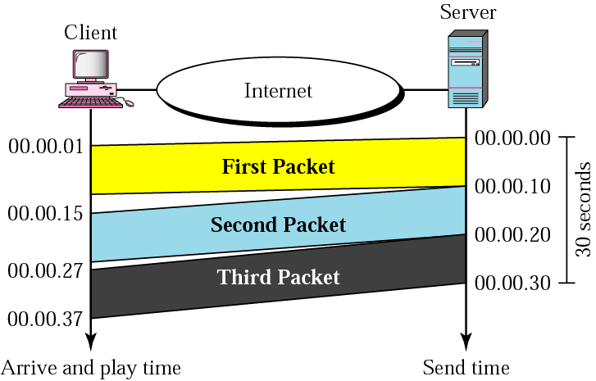
Jitter
Jitter is introduced in real time data by the delay between packets

Slide 66
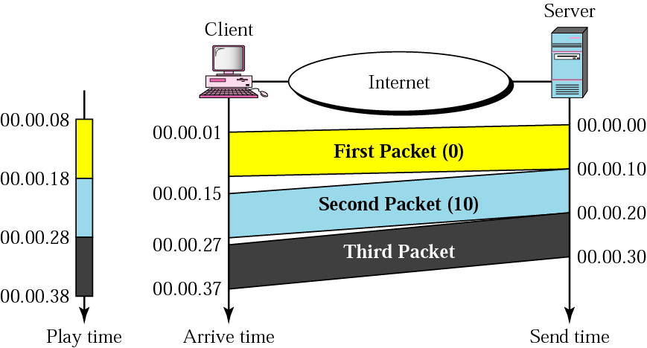
Timestamps

Slide 67
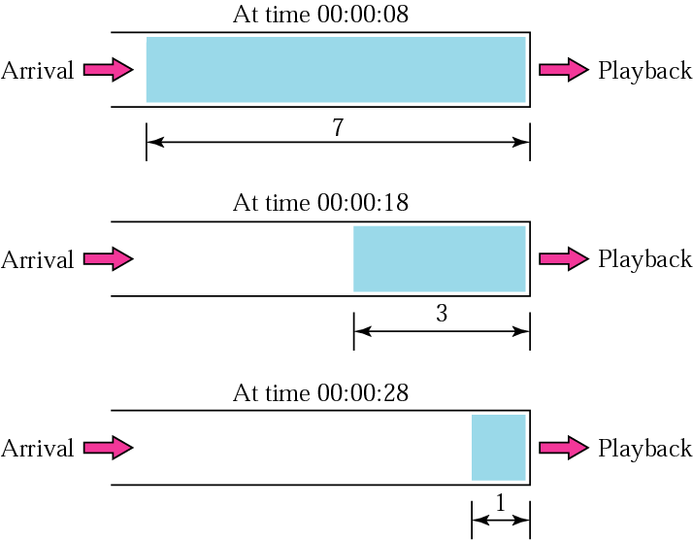
Playback Buffer
To prevent jitter, we can timestamp the packets and separate arrival time from the playback time

Slide 68
Real-time Traffic Issues
A playback buffer is required for real-time traffic
A sequence number on each packet is required for real-time traffic
Real-time traffic needs the support of multicasting
Mixing means combining several streams of traffic into one stream

Slide 69
Transport Protocol for RTP
TCP, with all its sophistication, is not suitable for interactive multimedia traffic because we cannot allow retransmission of packets
UDP is more suitable than TCP for interactive traffic. However, we need the services of RTP, another transport layer protocol, to make up for the deficiencies of UDP

Slide 70
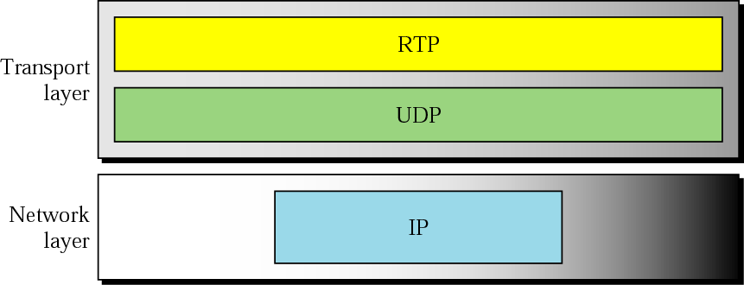
Transport Protocol for RTP
RTP uses a temporary even-numbered UDP port
RTCP uses an odd-numbered UDP port number that follows the port number selected for RTP

Slide 71
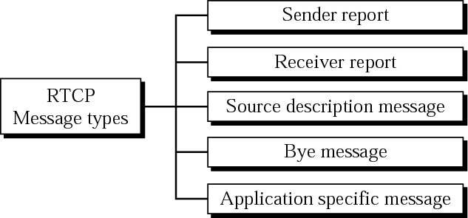
RTCP Message Types

Slide 72
Overlay Network Layered on Top of a Physical Network

Slide 73
Overlay Nodes Tunnel Through Physical Nodes

Slide 74
Multicast Trees Mapped Onto a Physical Topology

Slide 75
Multicast Tree Embedded in an Overlay Mesh

